Slide 1
How to Mow a Lawn
Event to Action teach back
Notes:
Slide Time: <1 minute

Slide 2
Introduction
- About me
- This is a safe space to learn
- Icebreaker activity – Best/Worst
Notes:
Slide time: 3 minutes
- About me
- Create a safe:
We welcome all levels & types of experiences.
We will ensure every learner has a voice.
We will respect differences.
- Best/worst is a simple icebreaker to implement in your small group. Ask each person to share their best and worst moments from the previous week. This is an easy one to use and gives you good feedback on how the people in your group are doing in a general sense.

Slide 3



PURPOSE – PROCESS - PAYOFF
PURPOSE This course addresses guide individuals transfer knowledge of how to effectively keep your lawn looking good and while avoiding injuries to yourself and others.
PROCESS It is designed to cover lawn mowing frequency, optimal mowing time, recommended grass height, risks involved in the process, and safety best practices for mowing.
PAYOFF
You will understand key attributes of a well-maintained lawn and how to perform the work safely.
Notes:
Slide time – 2 min.
Intent – explain the “Purpose, Process, and Payoff”
- Purpose (WIIFM) – Why does this content deserve to exist: Following the process will help you keep a well-maintained lawn that can act as a point of personal pride while also avoiding fines from HOA’s or the local jurisdiction due to an unsightly appearance. Put another way, this course addresses guide individuals transfer knowledge of how to effectively keep your lawn looking good and while avoiding injuries to yourself and others.
- Process: We’re going to teach you:
1. How often a lawn should be mowed
2. What time of day a lawn should be mowed
3. What the ideal height of the grass should be once mowed
4. What can go wrong if we’re unsafe
5. Best practices for lawn mowing safety
- Payoff: You will key attributes of a well-maintained lawn and how to perform the work safely.

Slide 4
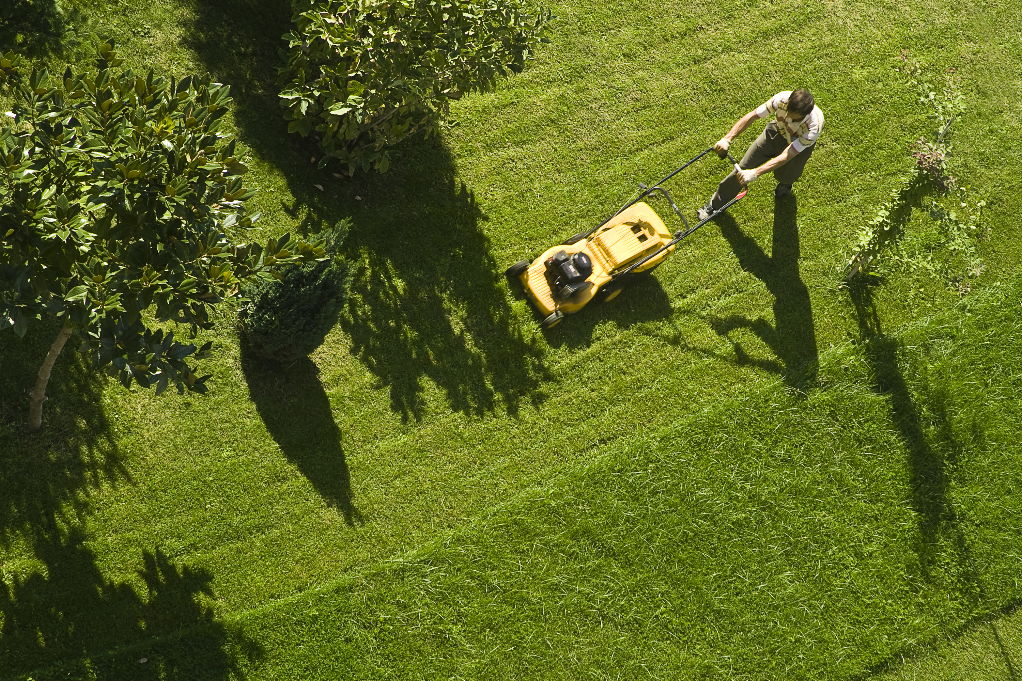
Mowing A Lawn – Did you know?
How often should you mow your lawn?
Rule of thumb is for a well-manicured lawn is to mow once a week during the growing season.
Notes:
Slide time: 1 minute
How often should you mow your lawn – A rule of thumb for a well-manicured lawn is to mow once a week during the growing season
Why – If mowed more frequently, you risk cutting it too short leading to overexposure of the elements. If mowed less frequently, your mower is more likely to become clogged and…..it just doesn’t look as nice.

Slide 5


Mowing A Lawn – Did you know?
What time of day should you mow your lawn?
Between 8am & 10am
Notes:
Slide time: 1 minute
What time of time should you mow the lawn – Between 8am and 10am
Why – It allows enough time for dew to dry allowing blades of grass to perk back up while avoiding the hottest temperatures of the day.

Slide 6
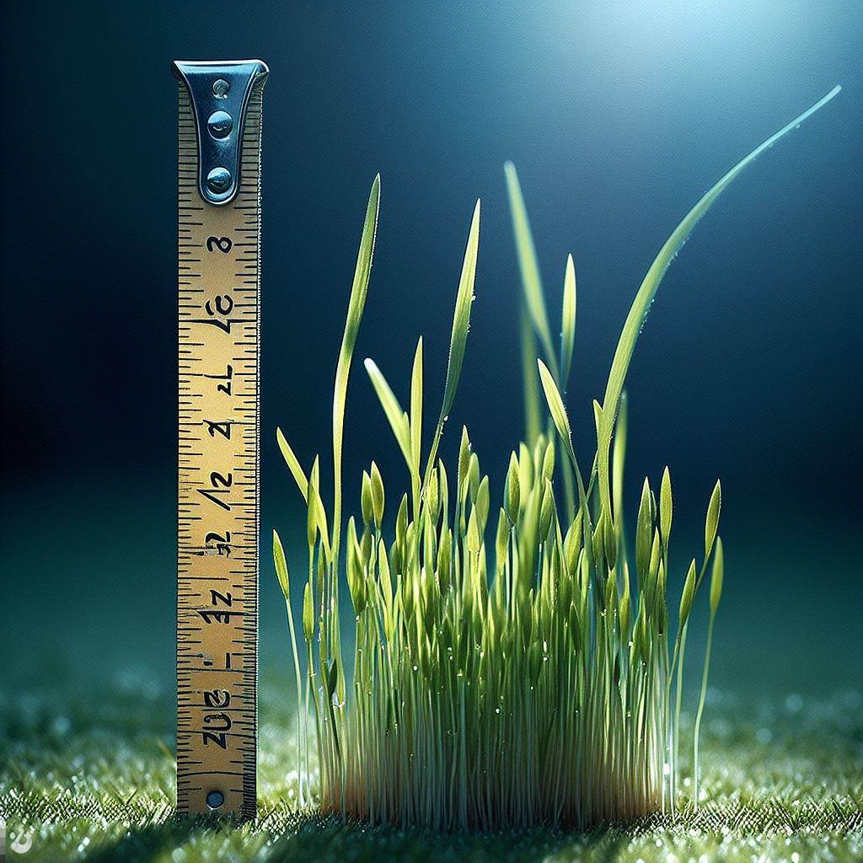
Mowing A Lawn – Did you know?
What is the ideal height we should keep our grass?
Rule of thumb is to keep your grass ~2 inches tall
Notes:
Slide time: 1 minute
What is the ideal height we should keep the grass – Rule of thumb is to keep your grass ~2” tall.
Why – Grass that’s cut too short is more susceptible to weeds, drought and heat damage.
TOFU: How often should we mow the lawn: 1 per week
TOFU: What time of day is best to mow: Between 8am and 10am
TOFU: What is the ideal height we should keep our grass: 2 inches tall

Slide 7
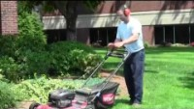
Mowing Safety
Notes:
Slide Time: 3 minutes
Role: Teacher
Mowing Injury Facts:
74k lawnmowing-related injuries occur in the US annually.
¼ of the injuries involve the hands, wrists, and fingers.
¼ of hand injuries involving lawnmowers result in amputation and shortening of hands, fingers, or writsts.
Best Practices:
Never let kids play around/near around a mower or around anyone mowing a lawn to avoid shrapnel or being caught in mowers path.
Do not use substances that would impair your ability to react to changing conditions
Avoid cutting in damp or wet conditions after a rainstorm. Damp grass is much more likely to clog the mower, setting up for a dangerous condition
If clogged, stop engine, remove keys and make sure any brakes or safety mechanisms are in place.
To unclog the mower, do not use your hands, feet or any other part of your body. Use a broom handle or long stick to remove/unclog the grass.
Pay caution to mowing on hills to avoid possible tip over of the mower.

Slide 8
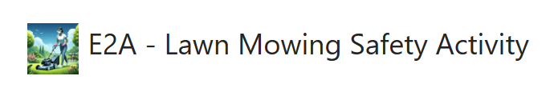
Activity
Notes:
Slide time: 4 minutes
Role: Teach/Coach/Pilot
E2A - Lawn Mowing Safety Activity (mcas.ms)
1. Introduce
2. Explain
3. Demonstrate
4. Debrief
5. Transition

Slide 9

What Would You Do?
Scenario 1:
You’re about to leave town for work this week and would like to get the lawn mowed before you go. Your neighbor’s kids are playing in the front lawn next door. What do you do?
Notes:
Slide time: 3 minutes
Role: Facilitator/Coach
“Now, having learned about how often to mow, what time to mow, ideal height of grass and general mowing safety, how would you handle the following situation:”
[Facilitator Conceptual Question - Directional] Scenario 1 possible answer: Let the kids know they’ll need to move while you’re mowing for their safety or just wait until you get back from your trip.

Slide 10

What Would You Do?
Scenario 2:
Your significant other wonders why you don’t mow the lawn first thing in the morning as you both have many other chores to get done that day. What is a possible explanation?
Notes:
Slide time: 3 minutes
Role: Facilitator/Coach
“Now, having learned about how often to mow, what time to mow, ideal height of grass and general mowing safety, how would you handle the following situation:”
[Facilitator Conceptual Question – Directional] Scenario 2 possible answer: Because the lawn is still wet from dew. That means the blades of grass aren’t standing fully upright which can lead to the grass not being cut to the ideal height. Additionally, cutting wet grass can lead to a clogged mower, which means additional time and safety measures must be taken to unclog the mower to keep your hands and fingers safe.

Slide 11
Summary
- You know now:
- How often a lawn should be mowed
- What time of day a lawn should be mowed
- What the ideal height of the grass should be once mowed
- What can go wrong if we’re unsafe
- Best practices for lawn mowing safety
- With this knowledge, we can have a well-maintained lawn and ensure our safety in the process.
Notes:
Slide time: 1 minute
Role: Pilot/Coach
- In the “what we’ve talked about section”, restate the initial 5 outcomes intended by taking this training (first addressed in the Payoff Section of “Purpose, Process, Payoff” on slide 3.
1. How often a lawn should be mowed
2. What time of day a lawn should be mowed
3. What the ideal height of the grass should be once mowed
4. What can go wrong if we’re unsafe
5. Best practices for lawn mowing safety
And when we apply this new knowledge and best practices, we can now change achieve our goals of having a well-maintained lawn and ensure our safety in the process.

